Slide 1
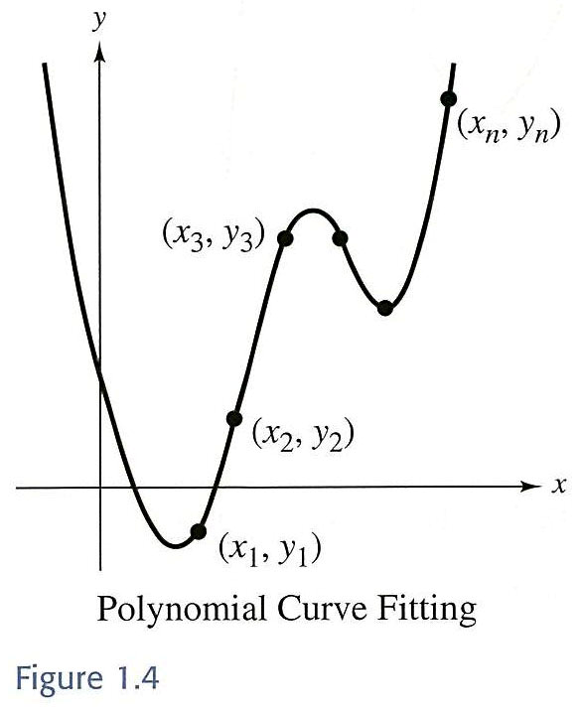

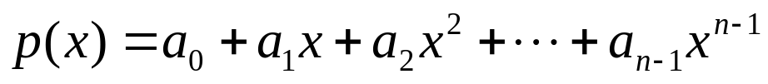
1.3 Applications of Systems of
Linear Equations
Polynomial Curve Fitting
fit a polynomial function to
a set of data points in the plane.
  n points:
  Polynomial function:
Network Analysis
focus on networks and Kirchhof’s Laws for electricity.
Ming-Feng Yeh
Chapter 1
1-<number>

Slide 2




Network Analysis
Section 1-3
Networks composed of branches and junctions are used as models in the fields as diverse as economics, traffic analysis, and electrical engineering.
The total flow into a junction is equal to the total flow out of the junction.
Example.
Ming-Feng Yeh
Chapter 1
1-<number>

Slide 3
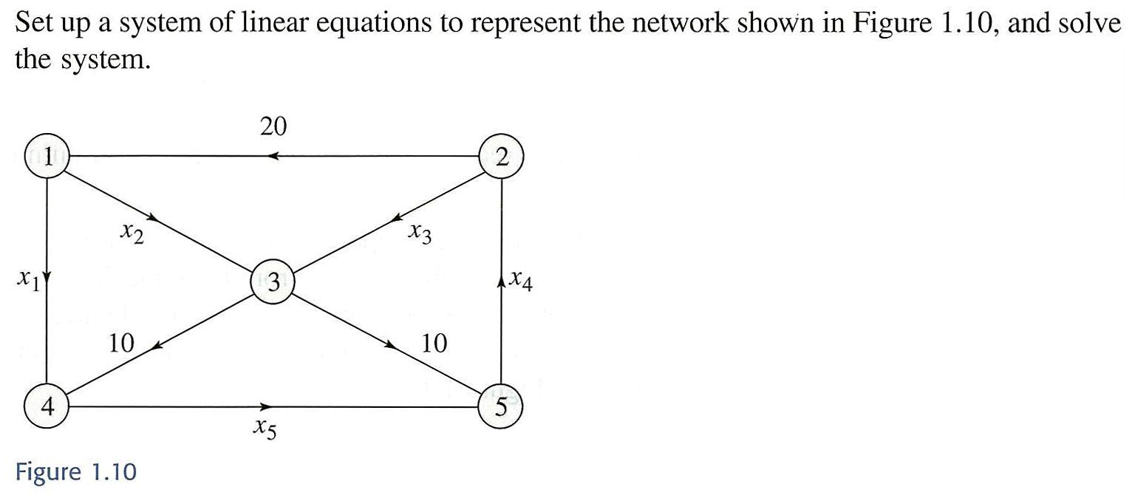
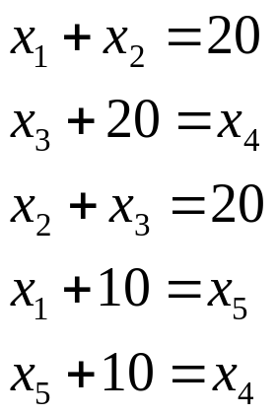
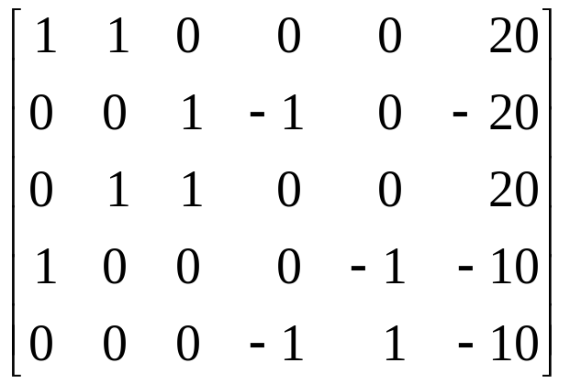
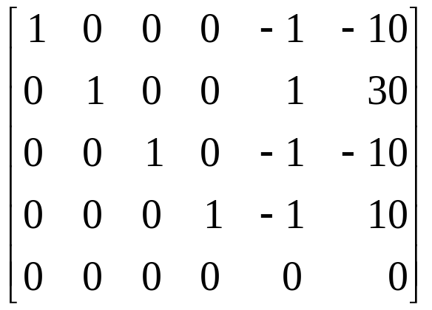
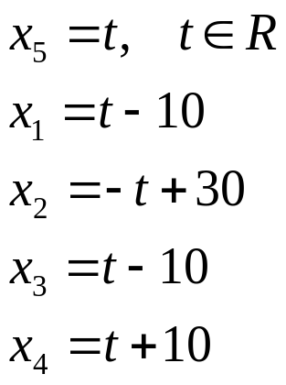
Example 5
Section 1-3


●
❍
■
Ming-Feng Yeh
Chapter 1
1-<number>

Slide 4
Kirchhoff’s Laws
Section 1-3
All the current flowing into a junction must flow out of it. (KCL)
The sum of the products IR (I is the current and R is the resistance) around a closed path is equal to the total voltage in the path. (KVL)
  A closed path is a sequence of branches such that the beginning point of the first branch coincides with the end point of the last branch.
Ming-Feng Yeh
Chapter 1
1-<number>

Slide 5
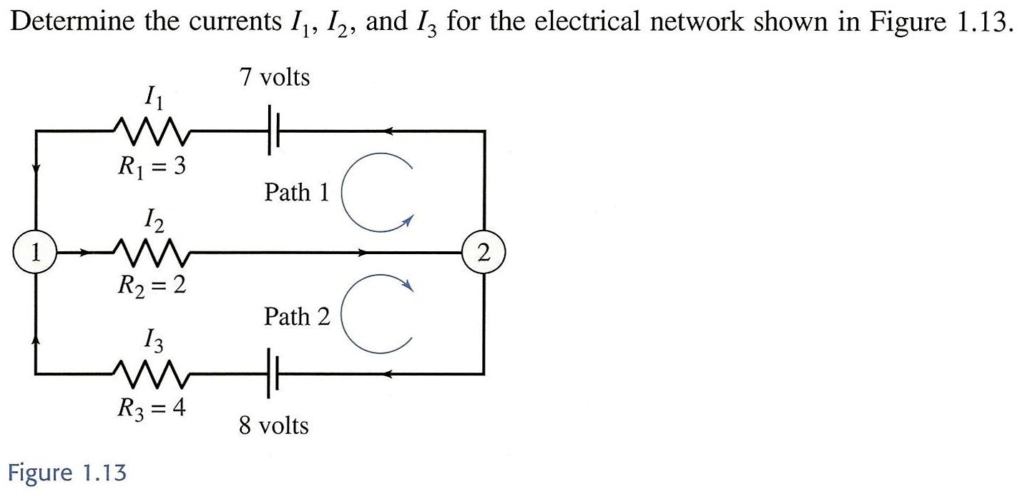



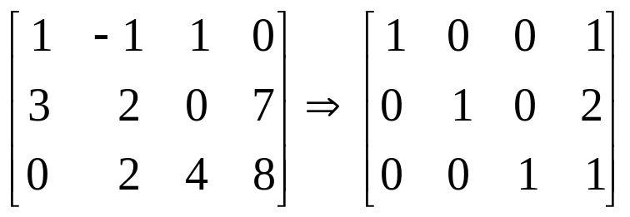
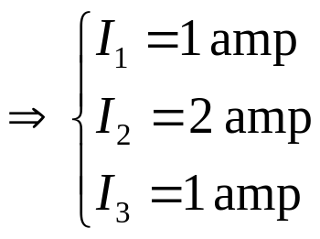
Example 6
Section 1-3
 or :
Path 1:
Path 2:
Ming-Feng Yeh
Chapter 1
1-<number>

Slide 6
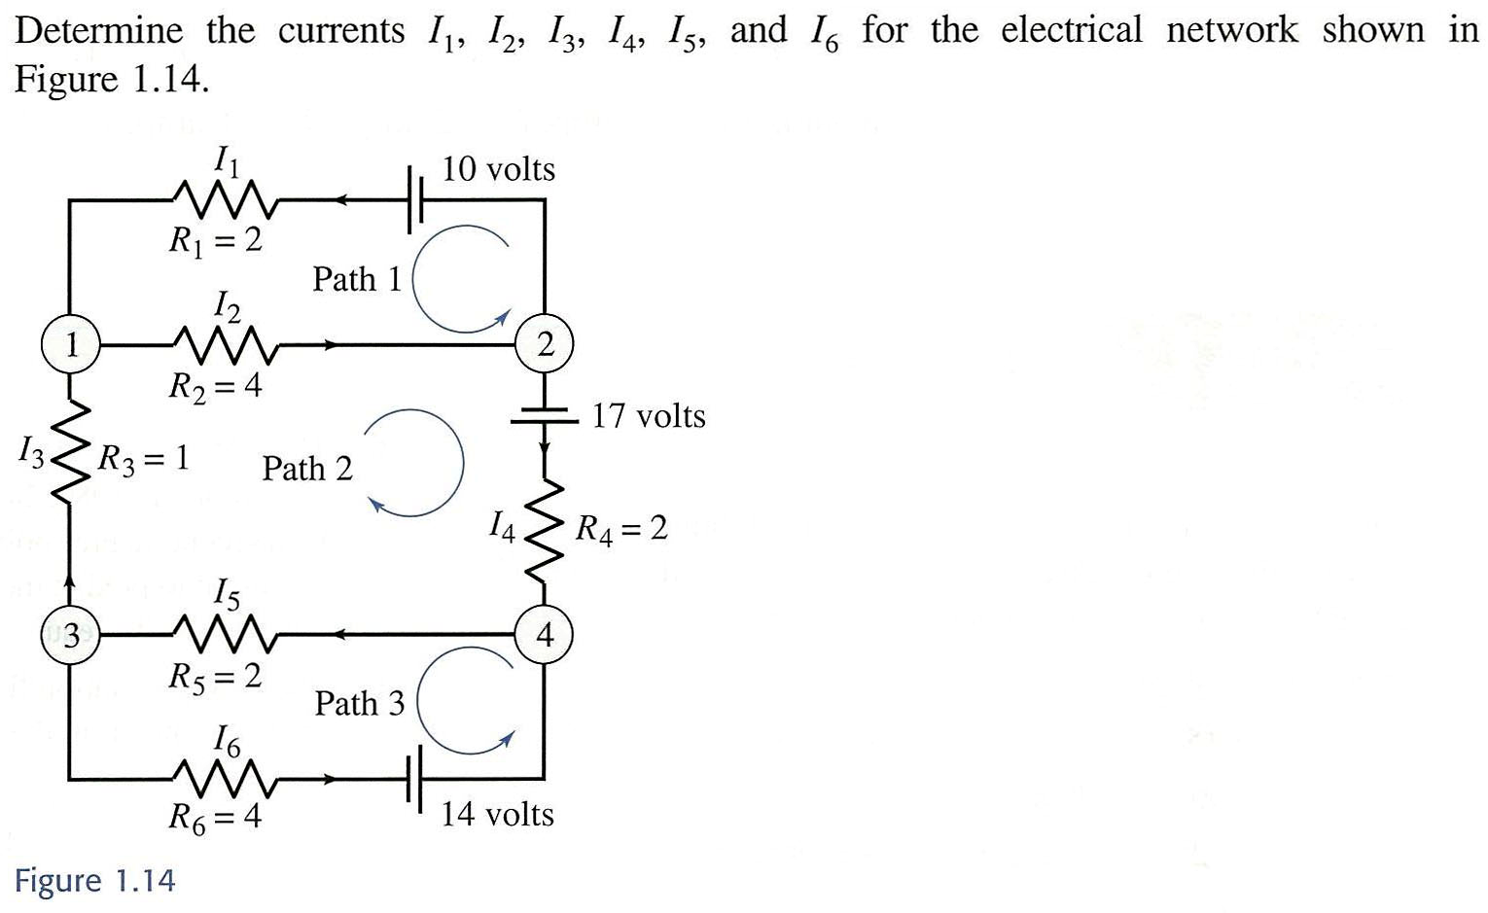
Example 7
Section 1-3
See pp. 37-38
in the textbook
Ming-Feng Yeh
Chapter 1
1-<number>

